Slide 1

Capstone Project
Book Recommendation System
By Shivani Thakur

Slide 2

CONTENT
Problem Statement
Data Understanding & description
Data Information
Data Processing
Checking Outliers
Data Visualization
EDA
EDA Conclusion
Recommender System
Model Evaluation
Conclusion

Slide 3

PROBLEM STATMENT
A book recommendation system is a type of recommendation system where we have to recommend similar books to the reader based on his interest. The books recommendation system is used by online websites which provide ebooks like google play books, open library, good Read’s, etc.
In a very general way, recommender systems are algorithms aimed at suggesting relevant items to users (items being movies to watch, text to read, products to buy, or anything else depending on industries).
Recommendation systems are used in hundreds of different services everywhere from online shopping to music to movies. Recommender systems are really critical in some industries as they can generate a huge amount of income when they are efficient or also be a way to stand out significantly from competitors.
The main objective of our project is to create book recommendation systems for users on various approaches .

Slide 4
DATA UNDERSTANDING & DESCRIPTION
We have 3 files in our dataset which is extracted from some books selling websites.
Books
ISBN - We have a unique ISBN number for all the books.
Users Data
User ID - A unique user id of all the users.
Location - City, state and country of the user.
Age - Age of the user
Ratings
Book Rating - Rating provide by the user for a particular book between 0-10
User ID & ISBN – Basically this to map book rating with other 2 data
Book Title – Book title correspond to the ISBN number.
Book Author - Name of book author
Year of Publication - In which year book published
Publisher - Publishing company/house name
URL Links (Image-URL-S, Image-URL-M, Image-URL-L), i.e., small, medium, large

Slide 5
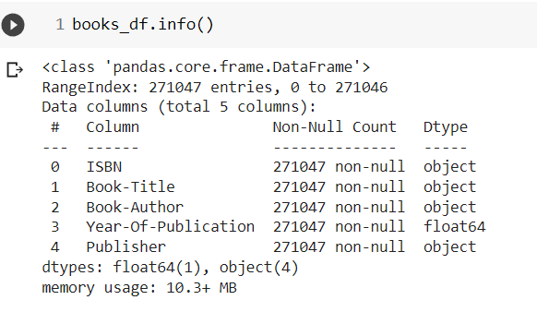
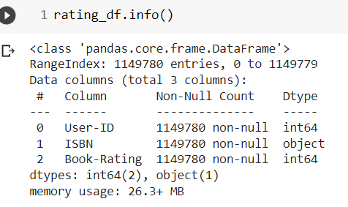
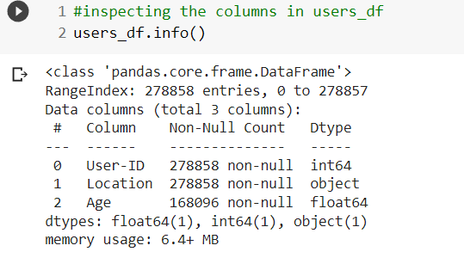
DATA INFORMATION
As you can see , rating df has no null objects while books and users df has null objects.

Slide 6

Data Processing
As we understand our data so before going further we will try to figure:
Checked duplicate:-There are no duplicates.
Null values and outliers .
Replaced null values and treated outliers.
There are some incorrect entries in data which was replaced with correct values

Slide 7
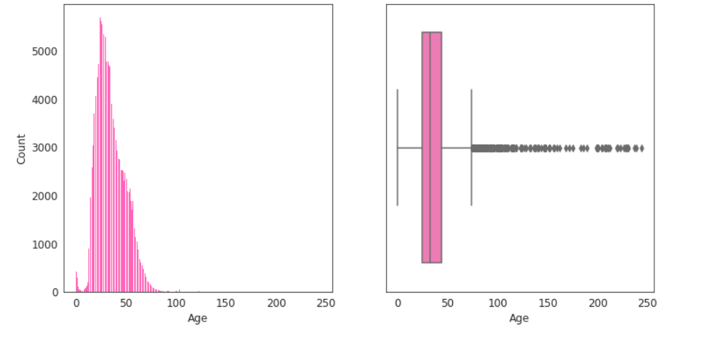
Checking Outliers
Most of the users are from the age group 25-50.
It is highly unlikely to have users under the age of 4 and above 100.The peaks near 0 and 100 in the kdeplot indicates that there are some outlier values in the 'Age' column
It is highly unlikely to have users of age above 95 and below 4 in this case.Let's replace these values with np.nan

Slide 8
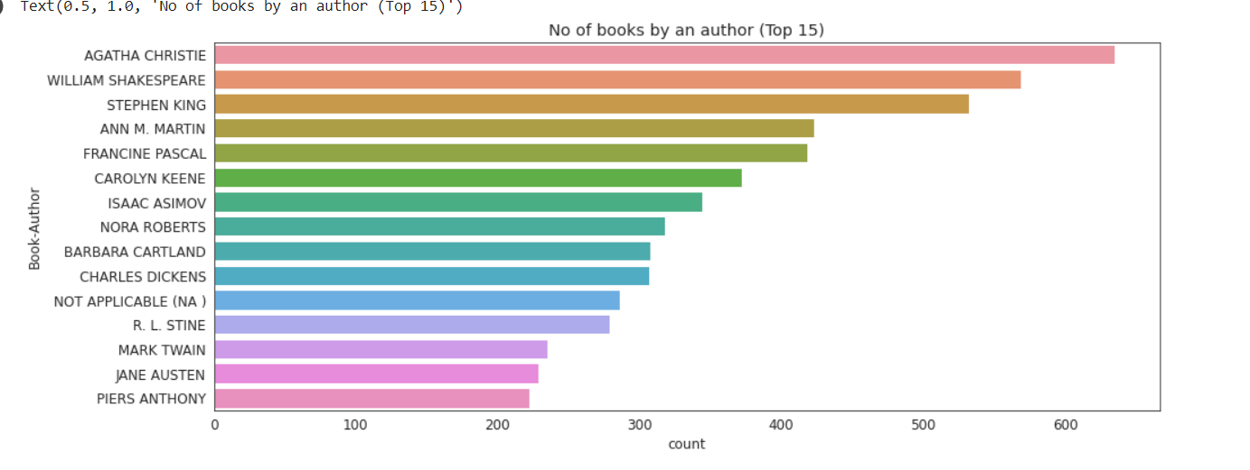
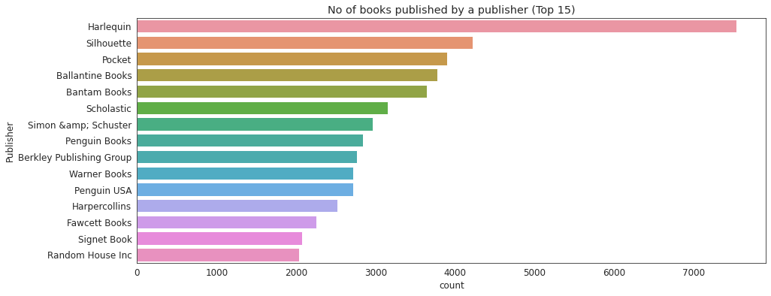
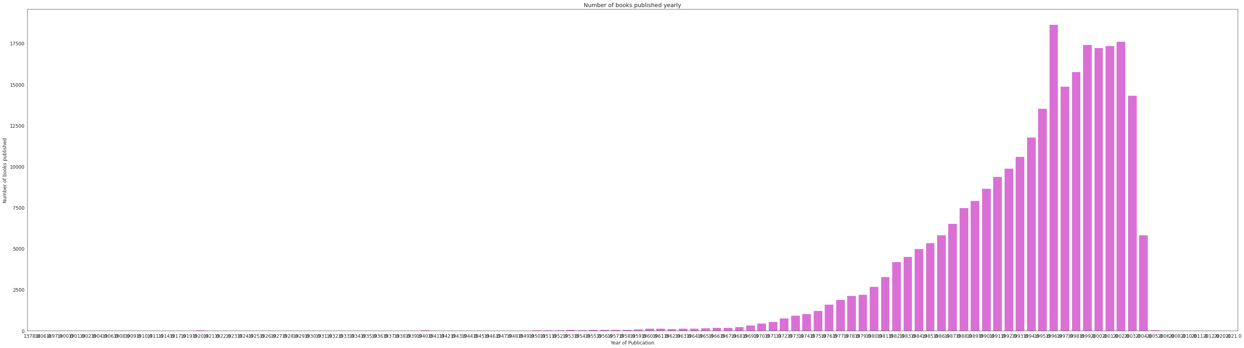
Data Visualization
Count of top 15 books published by publisher
Count of books by author
Count of books published yearly

Slide 9
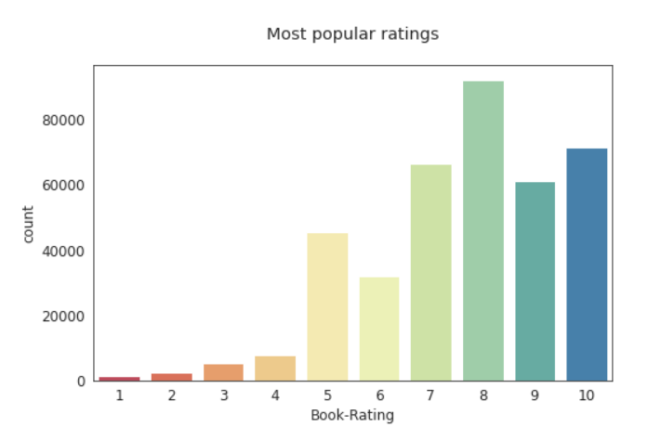
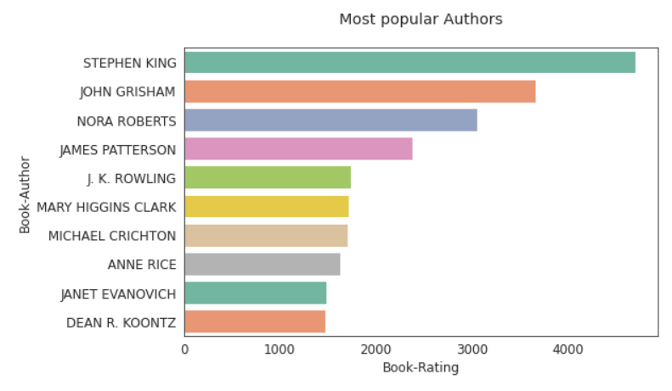
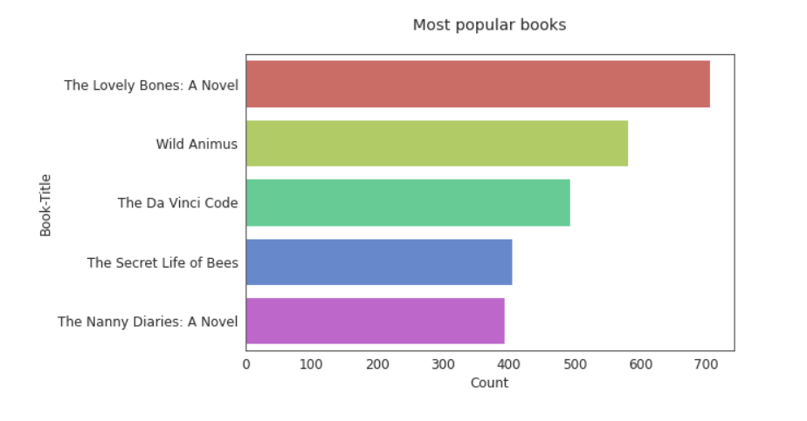
Exploratory Data Analysis
Book Data
The most popular author is Stephen King followed by John Grisham and Nora Roberts.
Most of users have given above 4 ratings to books 8 is the most common rating given by users.
The book which has been rated by most number of users is 'The Lovely Bones'

Slide 10
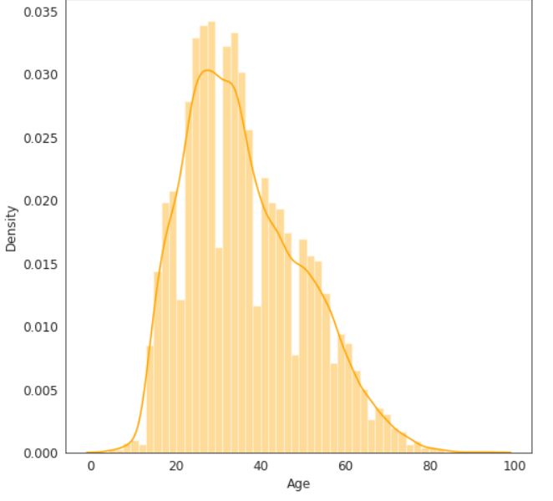
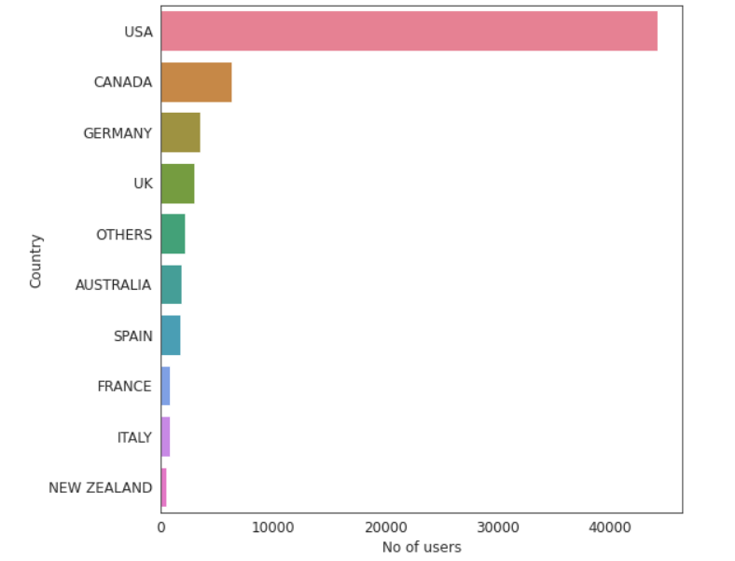
EDA : User Data
Age distribution of users
Countries with most readers
The majority of readers are between the ages of 25 and 40.
Readers who are 80 to 100 years old make up a tiny minority.
Most of the readers are from the United States. While other countries have very less users.

Slide 11
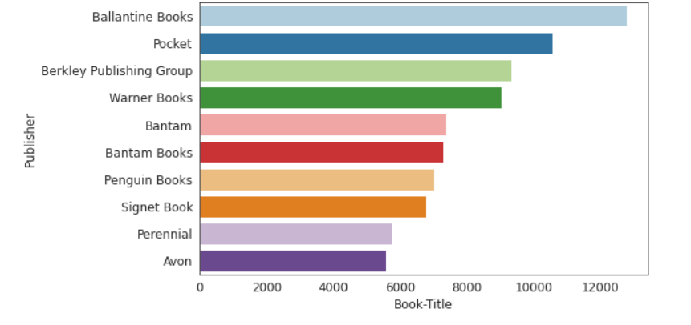
Publisher with most books
Here we have some top most rated publishers.
Ballantine Books is most popular publisher followed by Pocket and Berkley Publishing Group based on the number of users who have rated their books.
Perennial and Avon have the least ratings

Slide 12
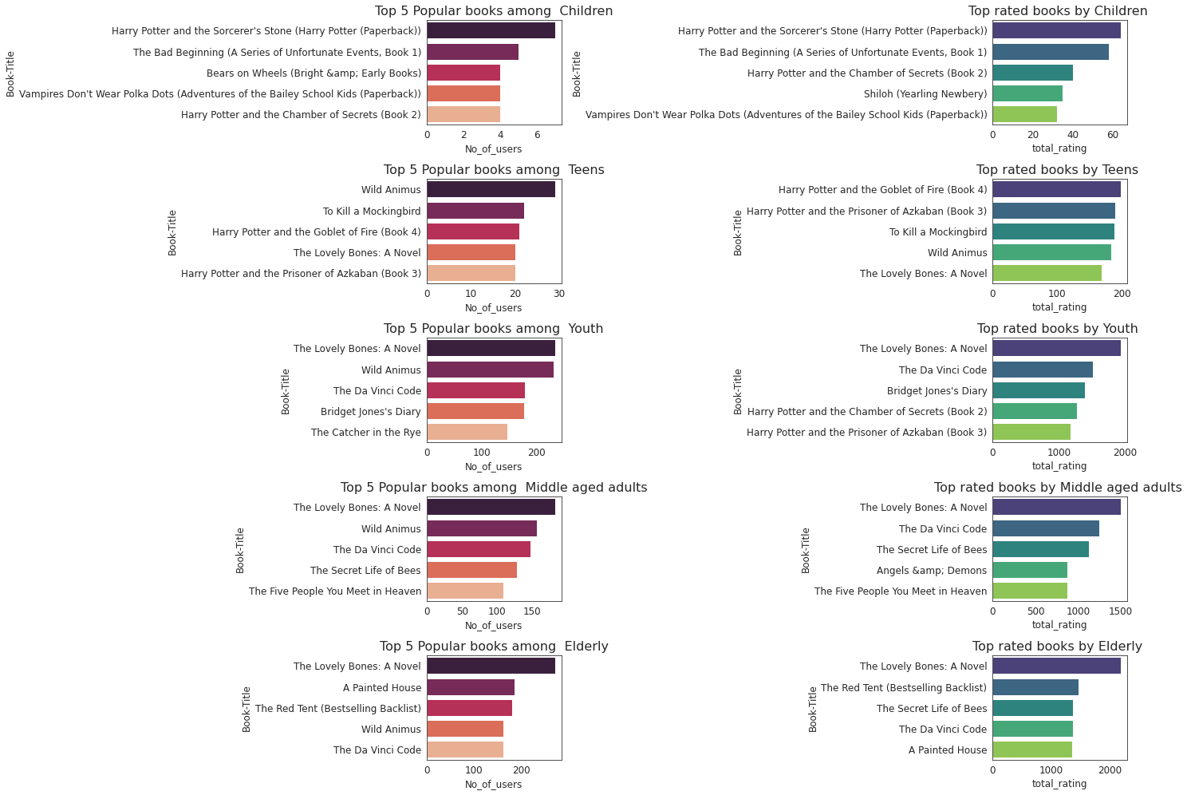
Top 5 Genres/Categories in the list

Slide 13

EDA CONCLUSIONS
The Lovely Bones: A Novel and Wild Animus are the two most read books.
Most popular book author based on the number of ratings is Stephan King .
Ballantine Books and Pocket are the top publishers based on the number of ratings that their books have received.
The majority of readers are between the ages of 20 and 40.
The majority of readers who have given the books ratings are from the United States and Canada.
Regardless of the age group, The Lovely Bones and Wild animus appear on lists of the top-rated books.

Slide 14
Recommender System
Popularity-Based Recommendation System
Collaborative filtering
Memory Based Approach
KNN with cosine metric
Collaborative filtering
SVD (Singular Value Decomposition)

Slide 15
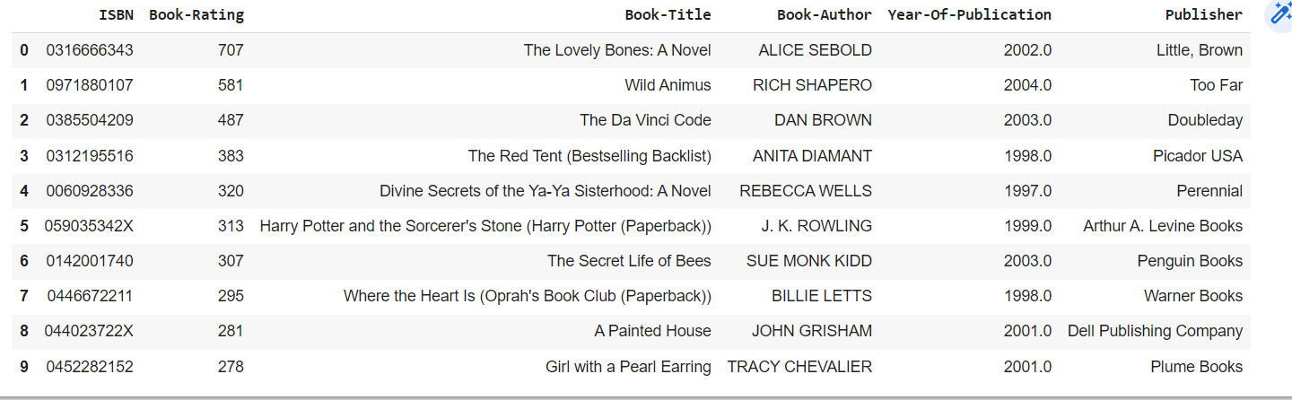
Popularity Based Recommender System
It is a type of recommendation system that bases choices on factors like popularity and/or current trends
This table indicates top 10 books based on rating given by maximum users.

Slide 16
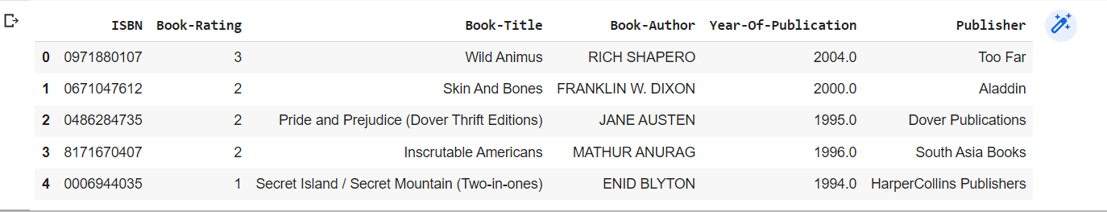

Country-based book recommendation
most popular recommendations country wise
E.g: India

Slide 17
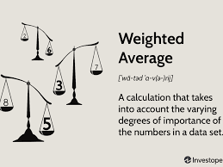
Weighted average rating method
Using Weighted average for each Book’s Average Rating
W = (Rv + Cm)/(v + m)
where
W= Weighted Rating
R = Average of the Books rating
v = No of people who have rated the books(number of votes)
m = minimum no of votes to be listed
C = the mean rating across all the books

Slide 18
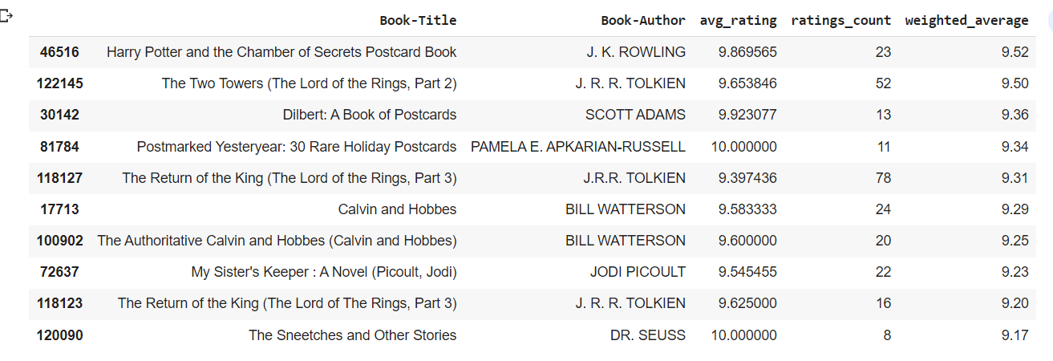
Weighted average rating of the books
This is the list of most favourite books based on the weighted rating scores. The book 'Harry Potter and the Chamber of Secrets Postcard Book' seems to have top this chart.

Slide 19
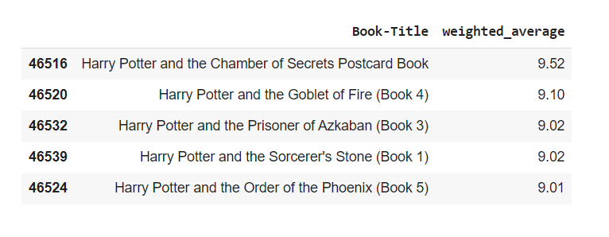
Author based recommender system
This recommender system recommends books from the same author as entered by the user.
The author of the book Harry Potter and the Chamber of Secrets is J. K. ROWLING
Here are the top 5 books from the same author

Slide 20
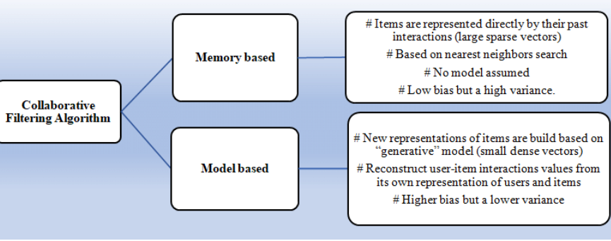
Collaborative filtering:
Collaborative Filtering is a Machine Learning technique used to identify relationships between pieces of data. This technique is frequently used in recommender systems to identify similarities between user data and items.
This means that if Users A and B both like Product A, and User B also likes Product B, then Product B could be recommended to User A by the system.

Slide 21
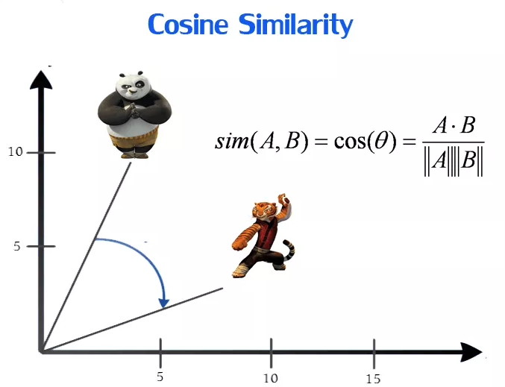
KNN Based Algorithm
Memory Based Approach
This algorithm takes into consideration up-to 'K' nearest users (in user based collaborative filtering) or 'K' nearest items (in item based collaborative filtering) for making recommendations. By default, the algorithm is 'user-based', and k is 40 (km in is 1). This means ratings of 40 nearest users are considered while recommending an item to a user. Some variants of this algorithm include with Means, with Zscore & Baseline wherein the average rating of users, or the normalized ZScore of ratings or the baseline rating are also considered as the system generates recommendations

Slide 22
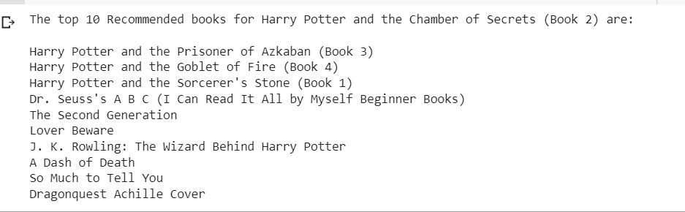
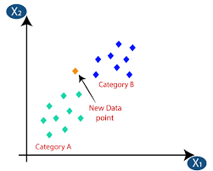
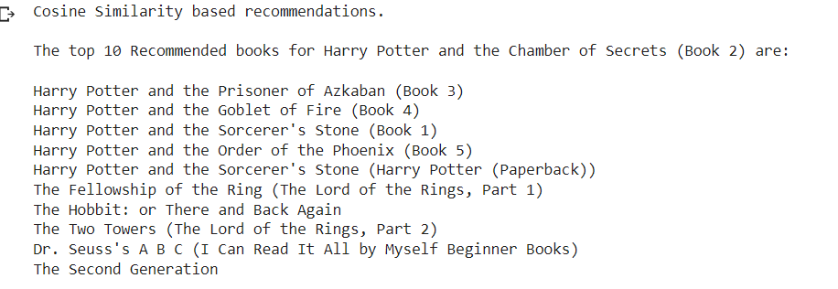
The top 10 Recommended books
KNN Based
KNN with cosine metric

Slide 23
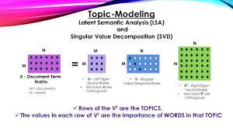
Model Based Approach
SVD (Singular Value Decomposition)
This algorithm takes a matrix factorization approach. The user-item rating matrix is factorized into smaller dimension user & item matrices consisting of latent factors (hidden characteristics). By default, number of latent factors is 100. These latent factors are able to capture the known user-item rating preference & in the process are able to predict an estimated rating for all user-item pair where user has not yet rated an item

Slide 24
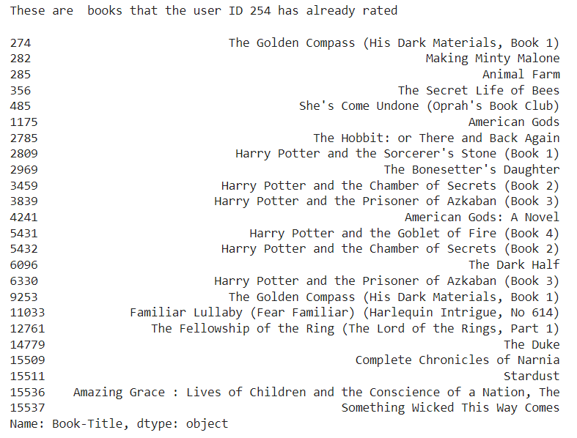

These are books that the user ID 254 has already rated

Slide 25
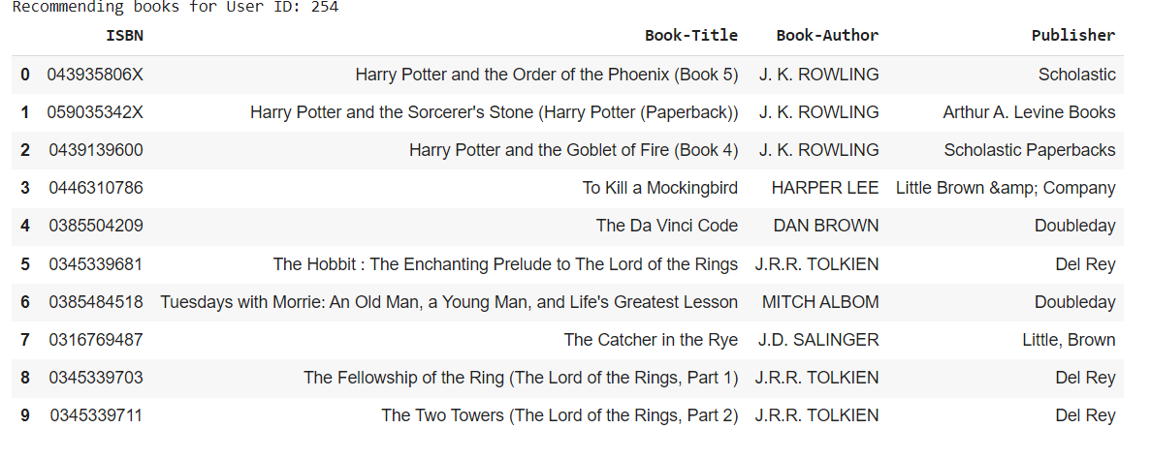
Recommending books for User ID: 254
SVD and NMF models comparison Singular Value Decomposition (SVD) and Non-negative Matrix Factorization (NMF) are matrix factorization techniques used for dimensionality reduction. Surprise package provides implementation of those algorithms.

Slide 26
Model Evaluation
In Recommender Systems, there are a set metrics commonly used for evaluation. We choose to work with Top-N accuracy metrics, which evaluates the accuracy of the top recommendations provided to a user, comparing to the items the user has actually interacted in test set. This evaluation method works as follows:
For each user
For each item the user has interacted in test set
Sample 100 other items the user has never interacted.
Ask the recommender model to produce a ranked list of recommended items, from a set composed of one interacted item and the 100 non-interacted items
Compute the Top-N accuracy metrics for this user and interacted item from the recommendations ranked list
Aggregate the global Top-N accuracy metrics

Slide 27
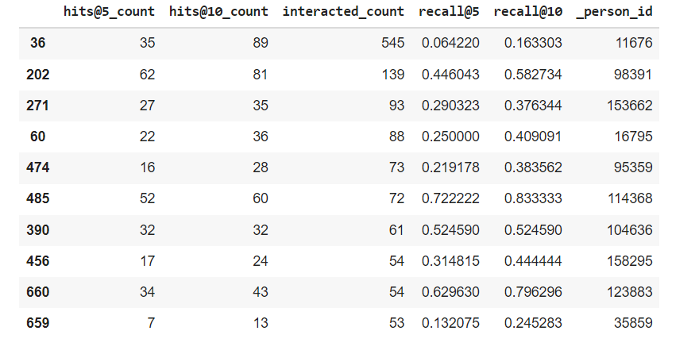
Evaluating Collaborative Filtering (SVD Matrix Factorization) model
Global metrics

Slide 28
CONCLUSION
In EDA, the Top-10 most rated books were essentially novels.
Books like The Lovely Bone and The Secret Life of Bees were very well perceived.
Majority of the readers were of the age bracket 20-35 and most of them came from North American and European countries namely USA, Canada, UK, Germany and Spain.
If we look at the ratings distribution, most of the books have high ratings with maximum books being rated 8.
Ratings below 5 are few in number.
Author with the most books was Agatha Christie, William Shakespeare and Stephen King.
We evaluated the performance of Singular Value Decomposition based recommender and obtained a Global Recall@5 of 30 % and Recall@10 of 41%

Slide 29
Thank You !

